Slide 1


Van Locks
9/2022

Slide 2
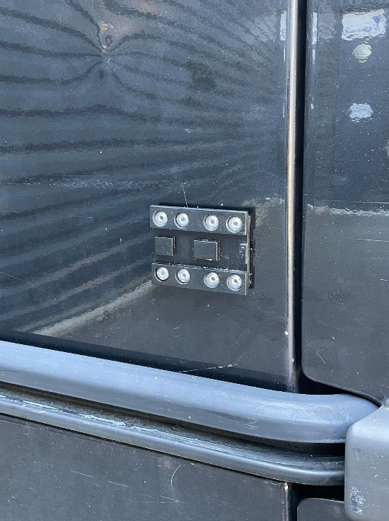
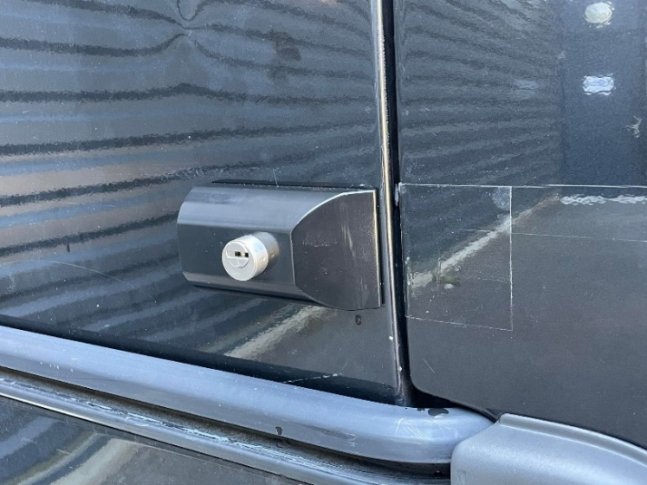
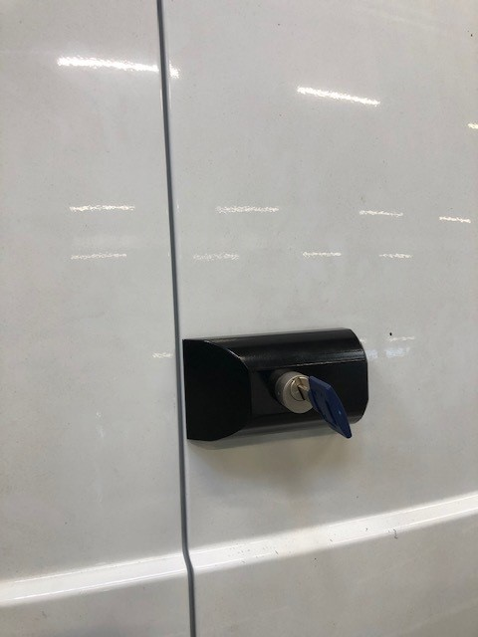
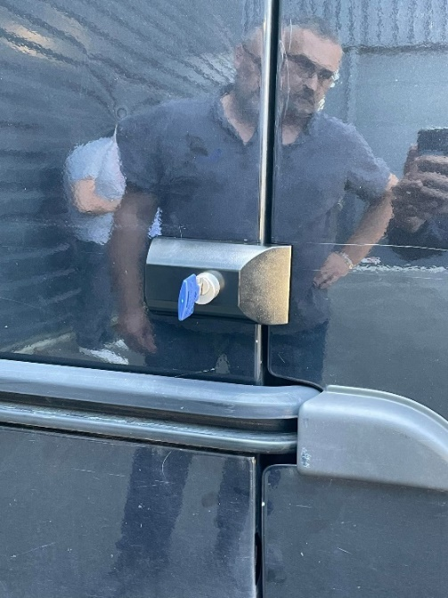
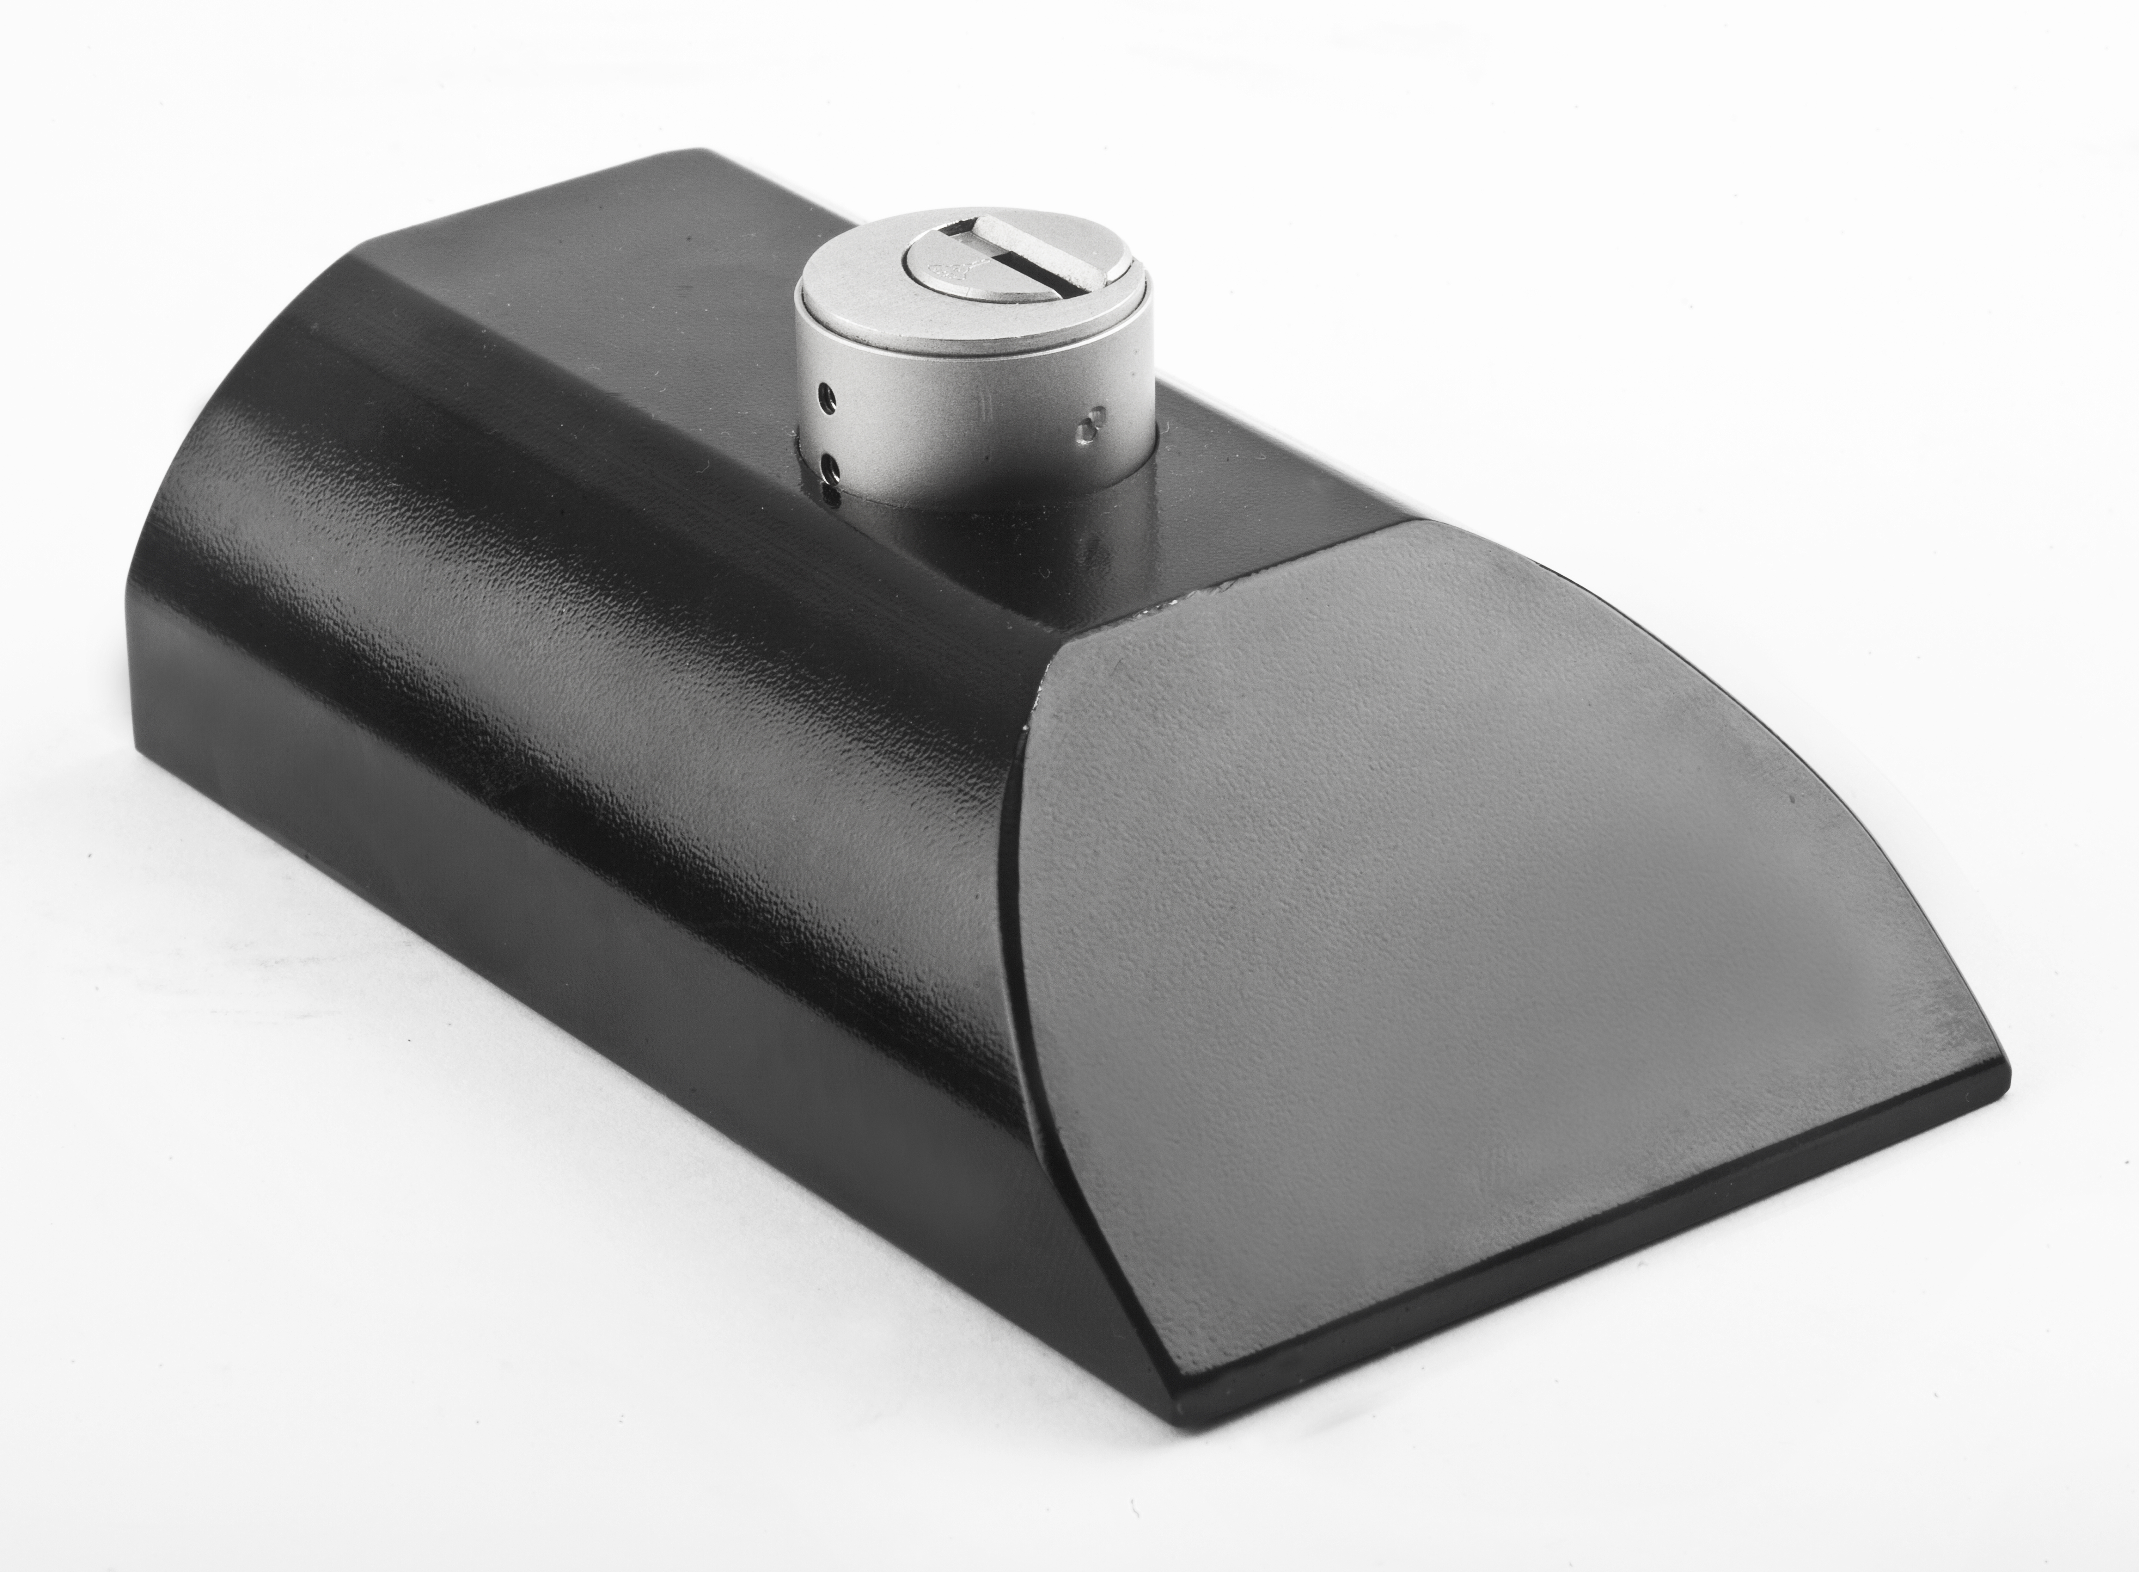
MVP1000 - New entry level van locking
For both rear and side doors.
Friendly and fast installation.
Suitable to be self-installed
Competitive cost and pricing.
User-friendly for end-user.
Suitable for most commercial vehicle models.
Sold separately or set of 2 keyed alike.

Slide 3
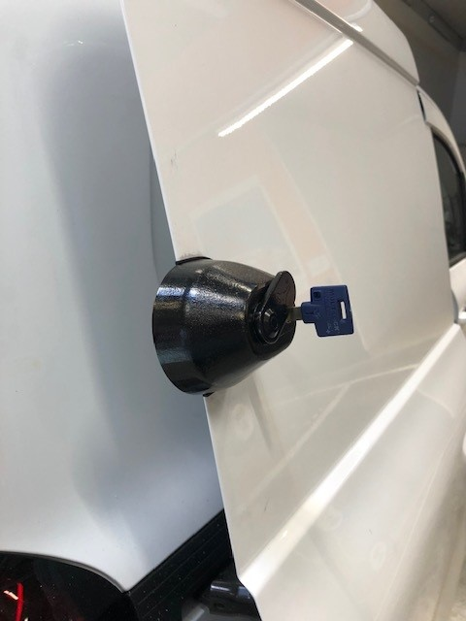
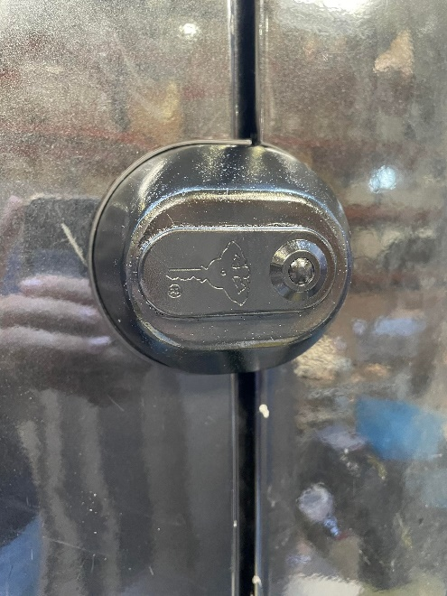
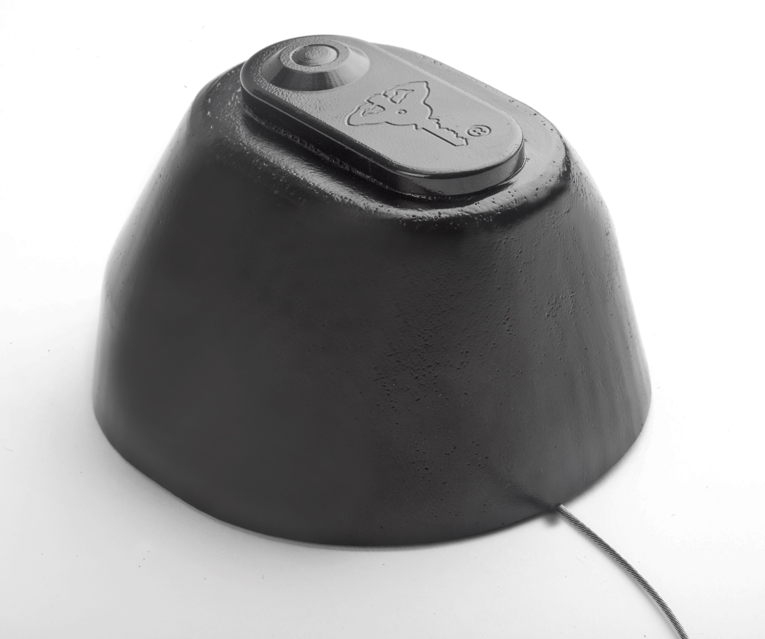
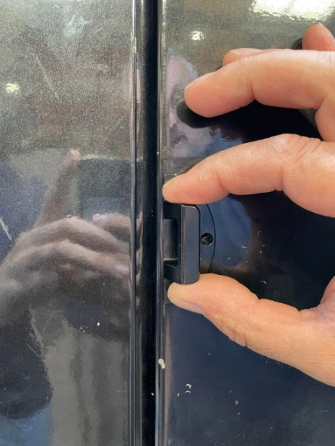
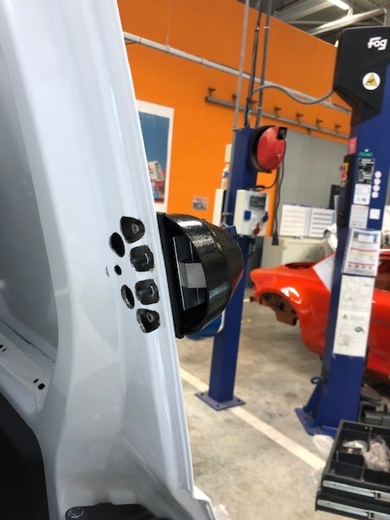
MVP3000 - New Van Locking solution
For both rear and side doors.
Rigid structure for high defence.
Friendly and fast installation.
User-friendly for end-user.
Includes emergency opening feature.
Suitable for most commercial vehicle models.
Includes dust shutter.
Sold separately or set of 2 keyed alike.

Slide 4
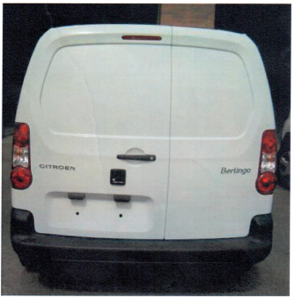
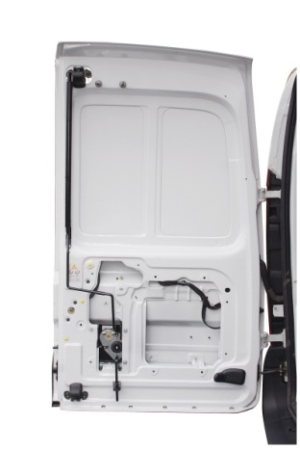
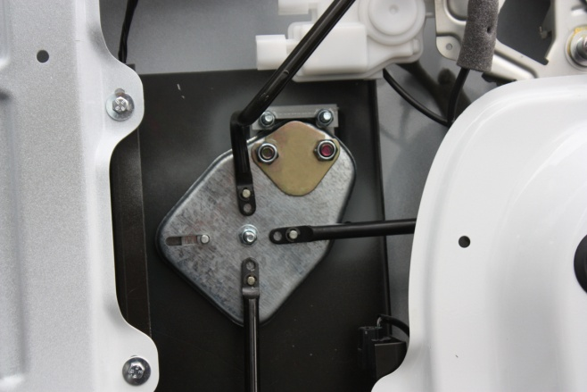
Multi-Point locking for rear and side doors
Locks the rear doors at 3 points
Prevents opening of the side sliding door
Totally blends with the exterior of the vehicle
Integrated micro-switch is optional
4

Slide 5
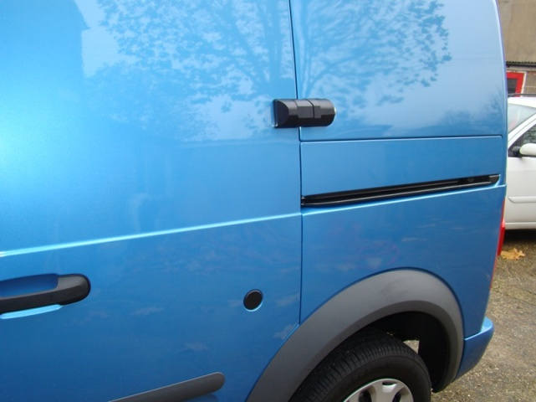
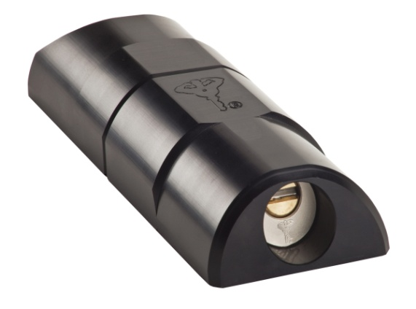
ArmaDLock
Robust structure prevents opening of the doors
Push-to-lock (without use of key).
Universal for all of kind of commercial vans
Fast installation
Key retaining and key-to-lock versions are possible
Can be used for many other applications
5

